Slide 1

Twitter Customer Complaint Sentiment Analysis

Slide 2

01
Objectives
02
Data
03
Methods
04
Results
Twitter Customer Complaints, Sentiment Analysis

Slide 3
Why?
Twitter Customer Complaints, Sentiment Analysis

Slide 4



Top 5 Companies with complaints
Avg CS Response Time
Sentiment Analysis
Twitter Customer Complaints, Sentiment Analysis

Slide 5






@
Tweet_id
Author_id
Inbound
Created_at
Tweet
Response_tweet_id
In_Response_tweet_id
Tweet unique Identifier
Author unique Identifier
If Tweet belongs to customer or Company
Full Date and Time tweet was created
Complaint from customer or response from either customer or company
Helps find the id of the tweet that the company answers
Helps find the id of the tweet that followed up after initial response
Twitter Customer Complaints, Sentiment Analysis

Slide 6
Column 1
Column 2
Column 3
Column 4
Column 5
NA
NA
In_response_tweet_id
Top Companies | Author_id | Inbound | Tweet (Complaint) | NA
AVG Response Time | Author_id | Inbound | Created at | Response_tweet_id
Sentiment Change | Tweet_id | Inbound | Tweet (Complaint) | Response_tweet_id
Twitter Customer Complaints, Sentiment Analysis

Slide 7


NLP (Natural Language Processing)
Will help the model understand each tweet and recognize certain patterns
Machine Learning
Machine learning will help us treat our information with algorithms in order to minimize flaws
Twitter Customer Complaints, Sentiment Analysis

Slide 8
Top 5 companies with complaints
Twitter Customer Complaints, Sentiment Analysis

Slide 9
Avg CS response time
Twitter Customer Complaints, Sentiment Analysis

Slide 10
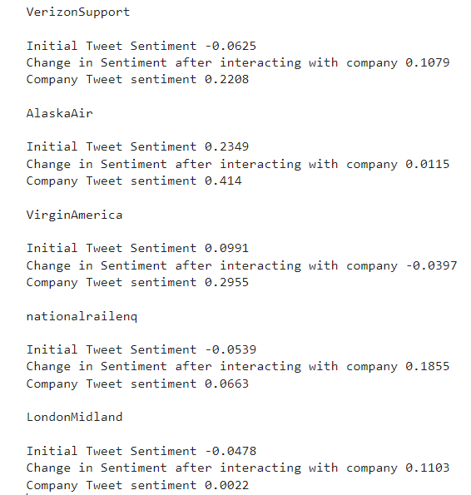
Sentiment Analysis
1 positive
0 neutral
-1 negative
Twitter Customer Complaints, Sentiment Analysis

Slide 11
What comes next…

Slide 12
Questions?
Twitter Customer Complaints, Sentiment Analysis

